Slide 1
R Basic Operations
Train
Data source
https://www.kaggle.com/competitions/spaceship-titanic/data

Slide 2
Data column
Passenger_Id A unique identifier for each passenger.
Home_Planet: The planet the passenger comes from.
Cryo_Sleep: Indicates whether the passenger was in cryosleep.
Cabin: Cabin number where the passenger stayed.
Destination: The destination of the passenger.
Age: Age of the passenger.
VIP: Indicates if the passenger was a VIP.
RoomService, FoodCourt, ShoppingMall, Spa, VRDeck: Amounts spent by the passenger on these services.
Name: Name of the passenger.
Transported: Indicates whether the passenger was transported.

Slide 3
Statistical Summary
Age: The average age of passengers is approximately 28.8 years, with a range from 0 to 79 years.
Expenditures (RoomService, FoodCourt, etc.): There are wide ranges in expenditure categories, suggesting diverse spending habits among passengers. Many passengers have zero expenditure in these categories, possibly indicating non-use of these services.

Slide 4
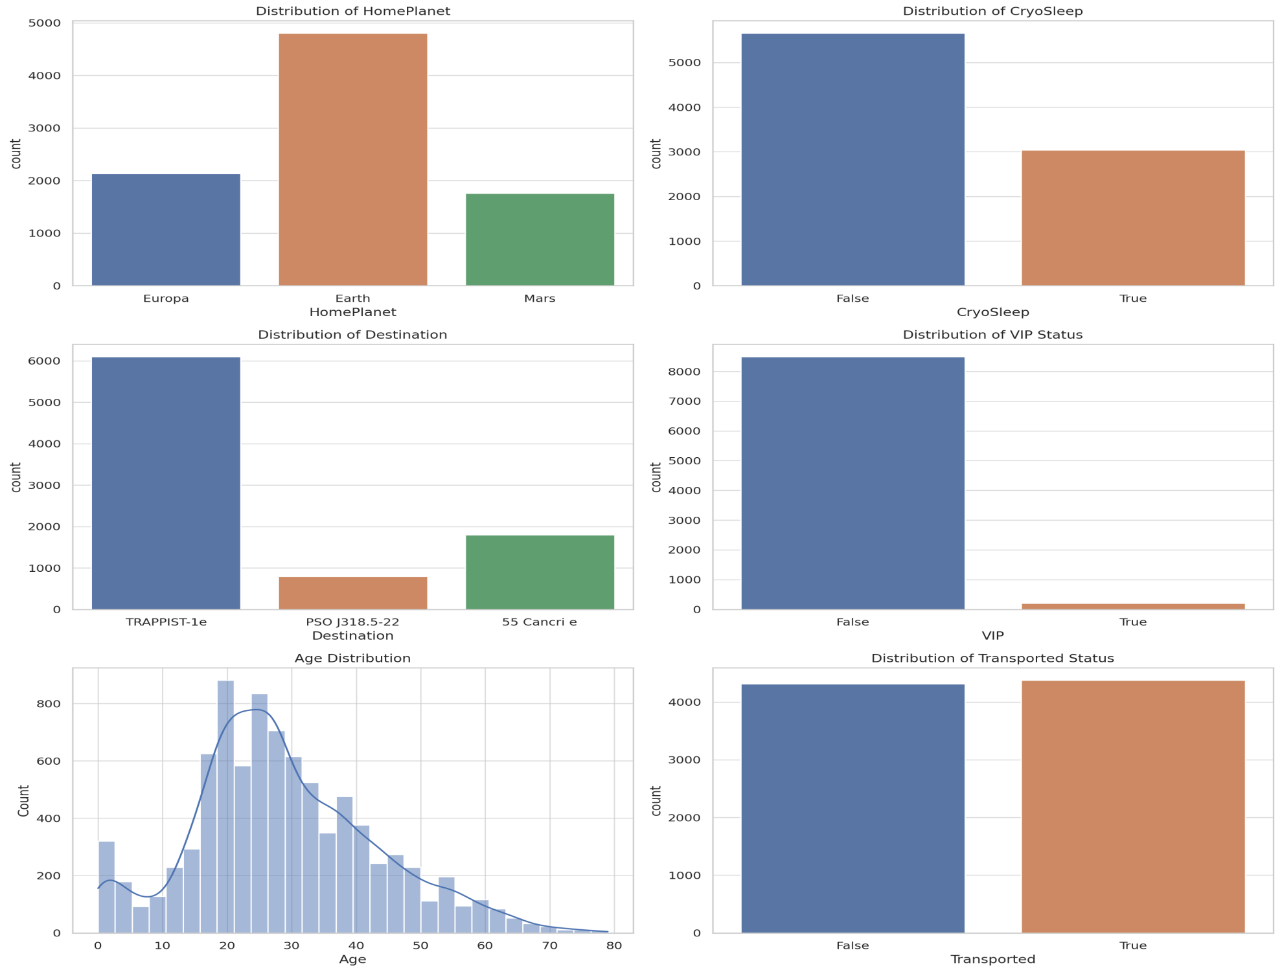

Slide 5
Visual Analysis of Key Variables
HomePlanet: The majority of passengers come from Earth, followed by Europa and Mars. This could imply different socio-economic backgrounds or preferences based on the home planet.
CryoSleep: A significant number of passengers were not in cryosleep. The choice of cryosleep might be linked to the duration of the journey or personal preferences.
Destination: Most passengers are headed to TRAPPIST-1e. The popularity of this destination could be an interesting point of study, possibly related to its characteristics or opportunities it offers.
VIP Status: Very few passengers are VIPs, indicating a small elite group with potentially different service usage or travel purposes.
Age Distribution: The age of passengers is fairly young on average, with a significant number in their late 20s. The distribution is slightly right-skewed, indicating a younger passenger demographic overall.
Transported Status: There's a relatively balanced distribution between those who were transported and those who were not.

Slide 6
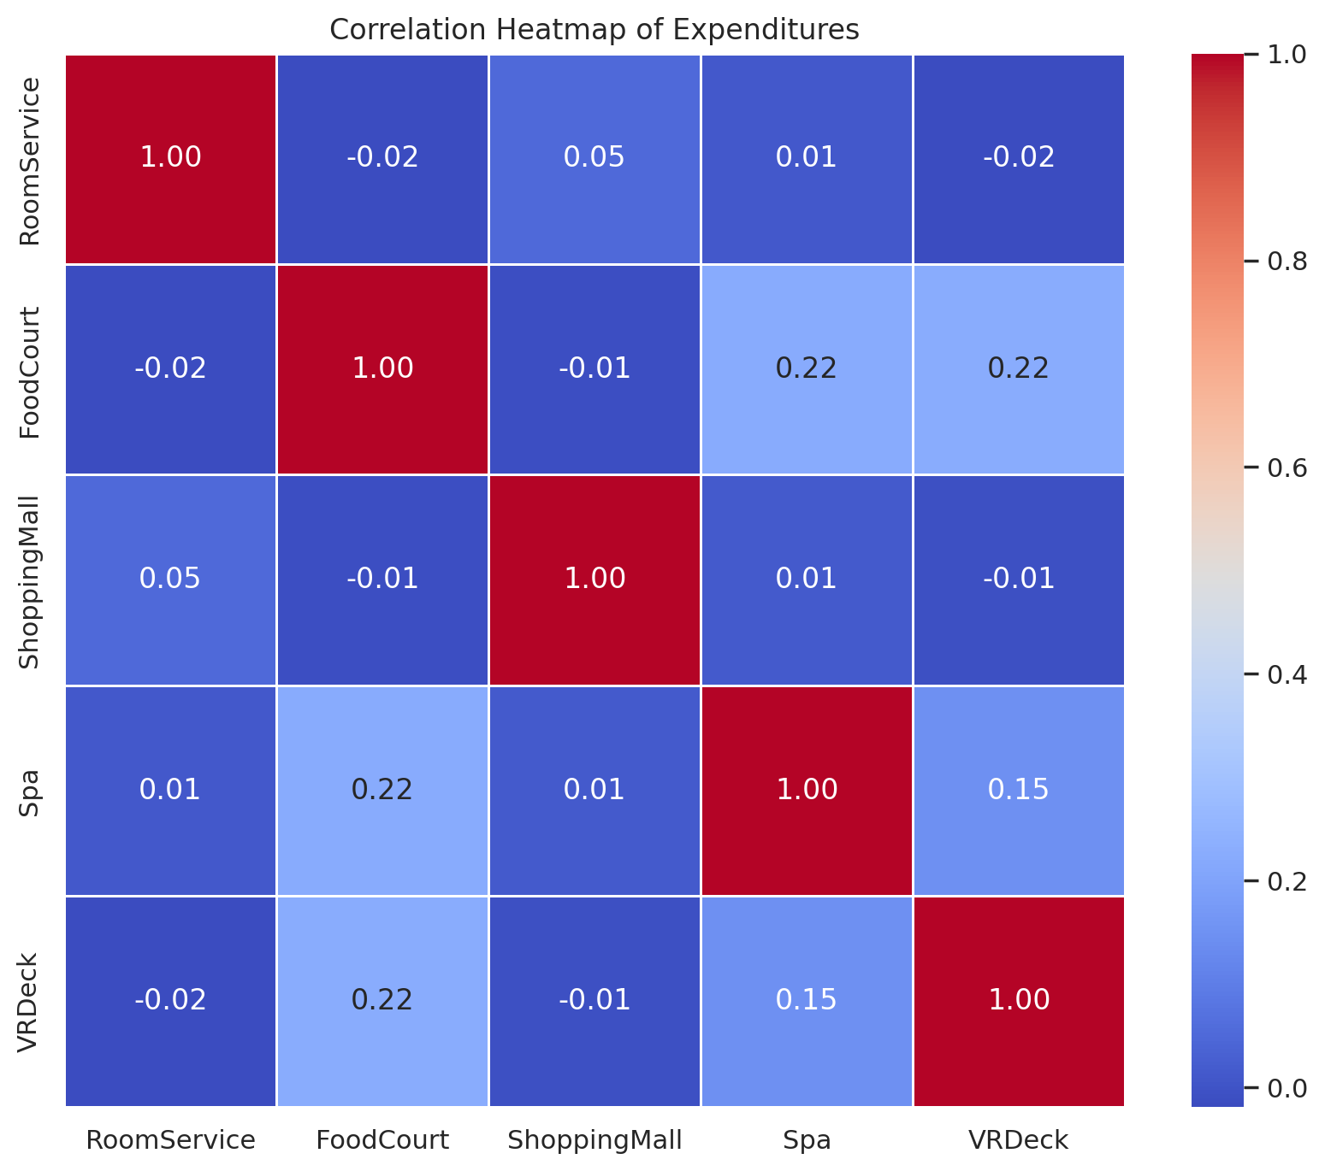

Slide 7
Correlation and Categorical Analysis
Correlation Heatmap of Expenditures:
1. The heatmap shows the correlation between different types of expenditures (RoomService, FoodCourt, ShoppingMall, Spa, VRDeck).
There are some moderate correlations, like between Spa and FoodCourt, VRDeck and FoodCourt, suggesting that passengers spending on one of these services might be likely to spend on others. However, most correlations are weak, indicating relatively independent spending behaviors in different categories.
Impact of HomePlanet on Transported Status.

Slide 8
Earth: A higher number of passengers from Earth were not transported compared to those who were.
Europa: More passengers from Europa were transported than not.
Mars: The numbers are relatively balanced, with a slight tilt towards more passengers being transported.
Impact of VIP Status on Transported Status:
Non-VIPs: There's a nearly equal distribution between transported and not transported.
VIPs: A higher proportion of VIPs were not transported compared to those who were interpretation.

Slide 9
Home Planet Influence: The difference in the transported status based on the home planet could suggest varying reasons for travel or conditions of the journey, affecting the likelihood of being transported.
VIP Status Effect: The fact that a higher proportion of VIPs were not transported is intriguing and might point to specific preferences or conditions associated with VIP status.

Slide 10
Targeted Marketing and Service Enhancement
The data shows distinct patterns in passenger backgrounds (HomePlanet) and preferences (like CryoSleep). A business could use this information to tailor marketing strategies or develop service offerings that cater to the predominant preferences of each passenger group.
For instance, marketing luxury or advanced technological amenities might be more effective for passengers from Europa, who showed a higher likelihood of being transported and possibly have different preferences or higher purchasing power.

Slide 11
Resource Allocation and Service Planning:
The spending patterns (RoomService, FoodCourt, etc.) and their correlations provide insights into where passengers are most likely to spend money. This information is crucial for resource allocation, such as staffing, inventory management, and service planning.
If a significant portion of revenue comes from specific services like Spa or FoodCourt, focusing on enhancing these services could be a profitable decision.

Slide 12
Customer Segmentation and Personalization:
The analysis reveals different behaviors and preferences among passengers, suggesting opportunities for customer segmentation.
Personalized services or packages could be developed for different segments, like special offers for families from Earth or premium packages for VIPs.

Slide 13
Risk Management and Operational Decisions
The VIP status analysis showed a unique pattern in transportation status. Understanding why a higher proportion of VIPs were not transported could be crucial for risk management and operational improvements.
If the issue is service-related, addressing these concerns could improve customer satisfaction and retention.

Slide 14
Strategic Planning for Future Journeys or Services
Insights from destination preferences and age demographics can inform future strategic planning. For example, if younger passengers are a major demographic, services catering to their preferences can be developed.
Destination popularity can guide the planning of future routes or promotional offers.

